Slide 1




Data-Limited Fisheries Toolkit
Evaluating management strategies for data-limited fish species
Custom input control MPs
Lecture 4c, Nov 22nd 2017
Tom Carruthers & Adrian Hordyk .

Slide 2
Agenda
Input control MP design
Effort controls
Spatial controls
Size limits

Slide 3
Design of input control MPs (class ‘Input’)
Very similar to output control MPs but rather than returning a vector of TACs that is reps long, input control MPs return a vector of input regulations:
AnInputMP = function(x, Data, ...) {
rec = new(‘InputRec’)
< code for calculating Effort, Spatial, Allocate LR5, LFR, HS, Rmaxlen, based on simulation x of Data >
rec
}
TAE: expressed as the fraction of current effort (effort in last historical year)
A number: e.g. Effort = 0.9

Slide 4
Design of input control MPs (class ‘Input’)
Very similar to output control MPs but rather than returning a vector of TACs that is reps long, input control MPs return a vector of input regulations:
AnInputMP = function(x, Data, ...) {
rec = new(‘InputRec’)
< code for calculating Effort, Spatial, Allocate LR5, LFR, HS, Rmaxlen, based on simulation x of Data >
rec
}
Degree of spatial closure (fraction of current effort) in the 2 areas of DLMtool.
A vector 2-long: e.g. Spatial = c(0.5, 1)

Slide 5
Design of input control MPs (class ‘Input’)
Very similar to output control MPs but rather than returning a vector of TACs that is reps long, input control MPs return a vector of input regulations:
AnInputMP = function(x, Data, ...) {
rec = new(‘InputRec’)
< code for calculating Effort, Spatial, Allocate LR5, LFR, HS, Rmaxlen, based on simulation x of Data >
rec
}
The fraction of effort in newly closed areas that is reallocated to open areas.
A number: e.g. Allocate = 0.5

Slide 6
Design of input control MPs (class ‘Input’)
Very similar to output control MPs but rather than returning a vector of TACs that is reps long, input control MPs return a vector of input regulations:
AnInputMP = function(x, Data, ...) {
rec = new(‘InputRec’)
< code for calculating Effort, Spatial, Allocate LR5, LFR, HS, Rmaxlen, based on simulation x of Data >
rec
}
The length at 5% retention
A number: e.g. LR5= 57.8

Slide 7
Design of input control MPs (class ‘Input’)
Very similar to output control MPs but rather than returning a vector of TACs that is reps long, input control MPs return a vector of input regulations:
AnInputMP = function(x, Data, ...) {
rec = new(‘InputRec’)
< code for calculating Effort, Spatial, Allocate LR5, LFR, HS, Rmaxlen, based on simulation x of Data >
rec
}
The length at 100% retention
A number: e.g. LFR= 92.1

Slide 8
Design of input control MPs (class ‘Input’)
Very similar to output control MPs but rather than returning a vector of TACs that is reps long, input control MPs return a vector of input regulations:
AnInputMP = function(x, Data, ...) {
rec = new(‘InputRec’)
< code for calculating Effort, Spatial, Allocate LR5, LFR, HS, Rmaxlen, based on simulation x of Data >
rec
}
The upper slot limit, a length above which there is zero retention.
A number: e.g. HS = 100

Slide 9
Design of input control MPs (class ‘Input’)
Very similar to output control MPs but rather than returning a vector of TACs that is reps long, input control MPs return a vector of input regulations:
AnInputMP = function(x, Data, ...) {
rec = new(‘InputRec’)
< code for calculating Effort, Spatial, Allocate LR5, LFR, HS, Rmaxlen, based on simulation x of Data >
rec
}
The retention of fish of maximum size.
A fraction: e.g. Rmaxlen = 0.213

Slide 10
An effort control MP using mean length data
MLTarg = function(x, Data, …){
rec = new(‘InputRec’)
currentYR = length(Data@Year)
rec@Effort = Data@ML[x, currentYR] / Data@L50[x]
rec
}
No spatial closure
No spatial reallocation
Size limit is not specified
Effort is current Effort multiplied by the ratio of mean length in the catch (ML) to length at 50% maturity (L50)

Slide 11
A fixed spatial control MP
Close1 = function(x, Data, …){
rec = new(‘InputRec’)
rec@Spatial = c(0, 1)
rec
}
Area 1 is shut
Effort is current effort
No spatial reallocation
Size limit is not specified

Slide 12
A fixed size limit
SL95 = function(x, Data, …){
rec = new(‘InputRec’)
rec@LR5 = 90
rec@LFS = 100
rec
}
Size limit is ~95cm, with allowance for +/- 5cm.
In this case length at 5% vulnerability is 90cm, length at full vulnerability is 100cm
Effort is current effort
No spatial closure
No spatial reallocation

Slide 13
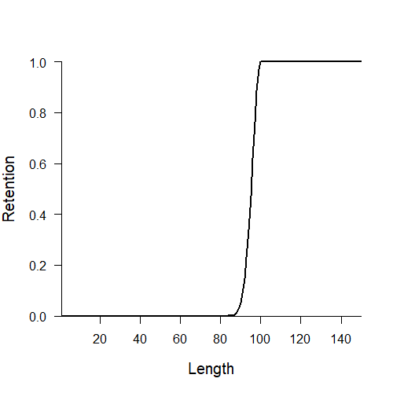
A fixed size limit
SL95 = function(x, Data, …){
rec = new(‘InputRec’)
rec@LR5 = 90
rec@LFS = 100
rec
}

Slide 14
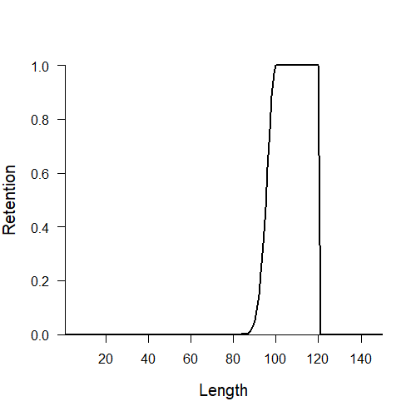
Another example: fixed size limit with a harvest slot
SL95_HS = function(x, Data, …){
rec = new(‘InputRec’)
rec@LR5 = 90
rec@LFS = 100
rec@HS = 120
rec
}
Upper slot limit

Slide 15
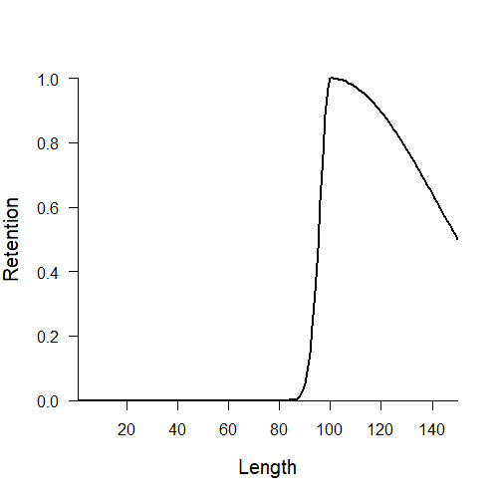
One more example: fixed size limit decreasing retention
SL95_dec = function(x, Data, …){
rec = new(‘InputRec’)
rec@LR5 = 90
rec@LFS = 100
rec@Rmaxlen = 0.5
rec
}
Retention of maximum size

Slide 16
Remember the last thing?
We have to assign the right class to our new MPs:
class(MLTarg) = class(Close1) = class(SL95) = “Input”

Slide 17
Remember the 3 more things?
We have to assign the right class to our new MPs:
class(MLTarg) = class(Close1) = class(SL95) = “Input”
They have to be visible to DLMtool:
environment(MLTarg) = environment(MLTarg) =
environment(SL95) = “DLMtool”
And they should be compatible with parallel processing:
sfExport(list=c(“MLTarg”, ”Close1”, ”SL95”))

Slide 18
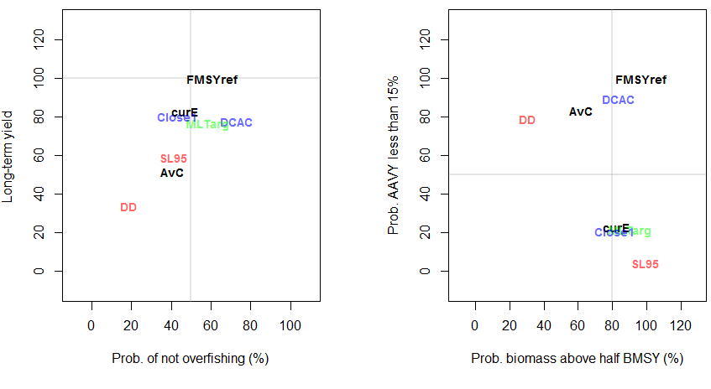
How did they do for an Albacore OM?

